Slide 1
Internetworking Essentials CSE307
Lab 0

Slide 2
Course details
Text Book
COMPUTER NETWORKS by ANDREW S. TANENBAUM, PEARSON

Slide 3

Course Assessment Model
4 CA Components

Slide 4
POLL 1
How many CA components are is LAB CSE 307
2
3
4
5

Slide 5


Reference Book 1 Ed 5
Text Book

Slide 6
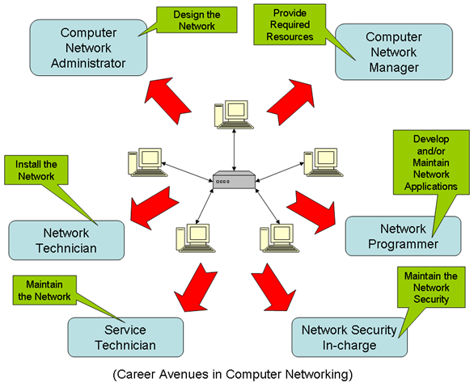
Why Study ?

Slide 7
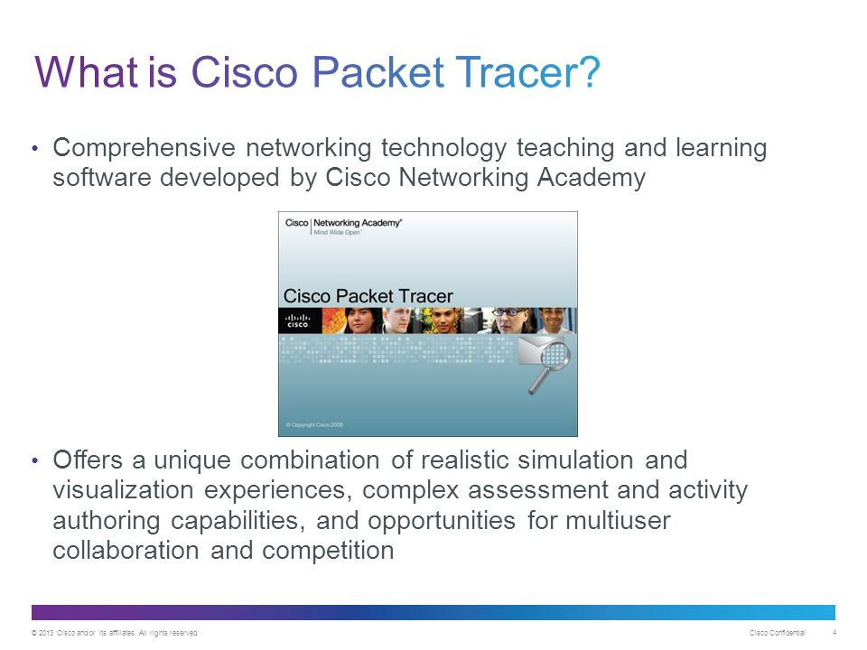

Slide 8
POLL 2
Packet tracer is simulation software offered by
Cisco
Dell
IBM
Hewlett Packard

Slide 9
syllabus
Network hardware and IP addressing concept
• Working of hub, switch and Router, Adding of interfaces in devices
• Cabling - Creation of straight and Cross cable using crimping tool
• IP addressing basics, configuration using CLI, VLSM and FLSM on single router
• Implementation of Star, Mesh, Bus and Hybrid Topology
Network Commands
• Ping, tracert, arp, netstat, ipconfig, ftp, nslookup, snmpget, snmpgetbulk and snmpset (use DOS and
scenario based configuration)
Network layer routing protocols
• Implementation of Static Routing using Classfull and classless (FLSM)
• Implementation of Static Routing using VLSM
• Routing information Protocol(RIP) using classfull and classless (FLSM)
• Routing information rotocol(RIP) using VLSM

Slide 10
Server Configuration and LAN Setup
• Implementation of FTP, Implementation of HTTP and Email setup on server
• Implementation of DNS, Implementation of DHCP
• Implementation of LAN with configuration of inter-networking devices and any application layer
protocol
IPv6 addressing and routing
• IPv6 Addressing & Stateless Address Auto Configuration (SLAAC)
• IPv6 Neighbor Discovery
• IPv6 Static Routing
• IPv6 Dynamic Routing

Slide 11
Link to download
https://www.computernetworkingnotes.com/ccna-study-guide/download-packet-tracer-for-windows-and-linux.html

Slide 12
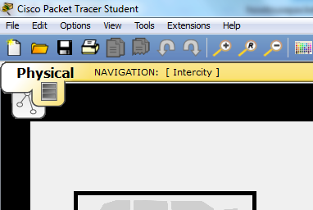
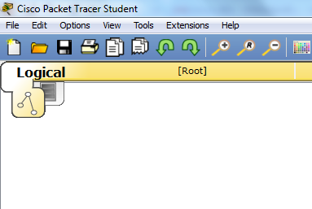
Packet Tracer has two different views
  Logical Workspace
  Physical Workspace

Slide 13
POLL 3
Which of the workspace we will use more in lab
logical
physical
Both
None of the above

Slide 14
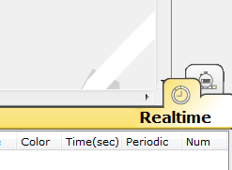
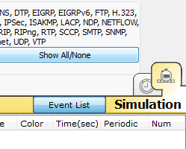
Packet Tracer also has two modes of operation
  Realtime Mode
  Simulation Mode

Slide 15
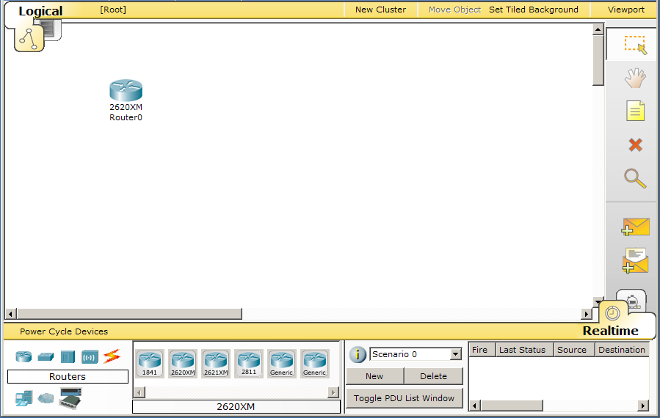


Basics to Create the Devices
1. Click the Select tool, if necessary.
To create a device:
4. Click on the workspace.
2. Choose a device type.
3. Choose a device.
Notes:
Slide 6 – Create the Devices
The large white space that opens by default is the workspace where you will create your topology. You can use the entire white space and can even scroll down and to the right to utilize a larger area.
Since our topology is very small, we will use only the left portion of the screen. This will help us with workspace later when we are running a simulation.
In this demonstration, we can use any of the routers listed. In other topologies, you may direct students to use specific router types, as you may need specific modules added to the devices.

Slide 16
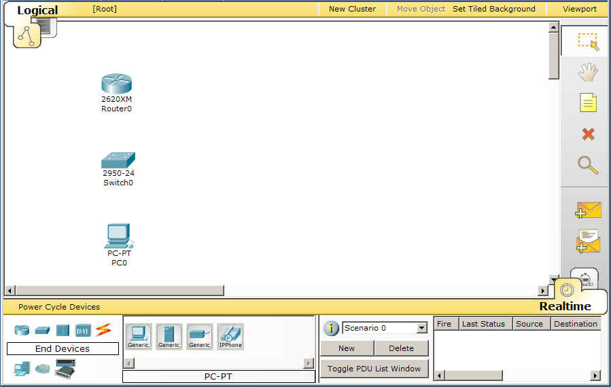
Common Tools
The Common Tools bar includes:
Select tool for selecting
Move tool for moving the entire topology
Note tool for adding notes anywhere on the topology
Delete tool for removing devices and links
Notes:
Slide 7 – Common Tools
The Common Tools Bar contains tools you will use regularly to interact with the work space:
The Select tool is used to drag, highlight and select devices.
The Move Layout tool is used to move the workspace
The Place Note tool is used to add notes or labels in the workspace
The Delete tool is used to delete devices and links.

Slide 17
Some Tips
A Few Tips:
You can create multiple instances of the same device by holding down the CTRL key.
Cancel creating a device by clicking on it again or another tool. Also, the ESC key will cancel any action.
Multiple devices can be selected at one time using the select tool and dragging a box around the desired devices.
Notes:
Slide 8 – Some Tips
If you would like to create multiple instances of the same device, hold down the CTRL key before clicking on the device. Click in the workspace placing a new device with each click.
To cancel the process of creating multiple instances, click on the device again. (You can also hit the ESC key or simply click on another tool.)
Devices can be dragged to a new location. Multiple devices can be selected by clicking and dragging a selection box around the desired devices. You can also hold down the SHIFT key while you click on multiple devices you wish to make part of your multiple selections. Once selected, highlighted devices can be moved around as a unit.
A multiple selection can also be deleted by clicking on the Delete tool. The Delete tool can also be used to delete one device at a time.
Use the Move Layout tool in place of the horizontal and vertical scroll bars to reposition your topology if it gets too big or if other windows are blocking your view.
Use the Place Note tool to add information directly to the topology instead of using the Network Information window.
The Inspect tool allows you to look at a device’s table such as the ARP, MAC and routing tables.
At any point, you can save your topology using the Save button on the tool bar or the Save command from the File menu. Be sure to save it with the .pkt extension.

Slide 18
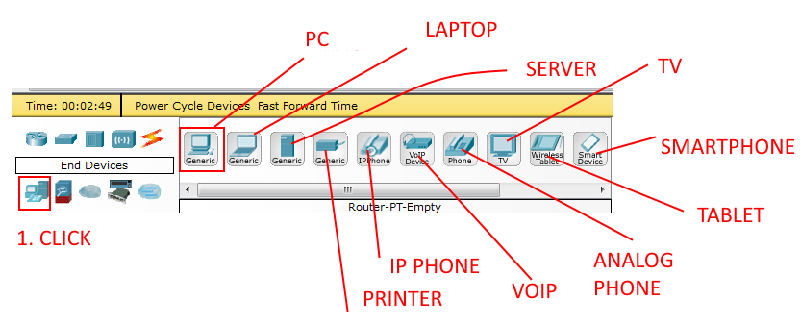
Some End devices
Under End Devices, these are the following devices available:

Slide 19
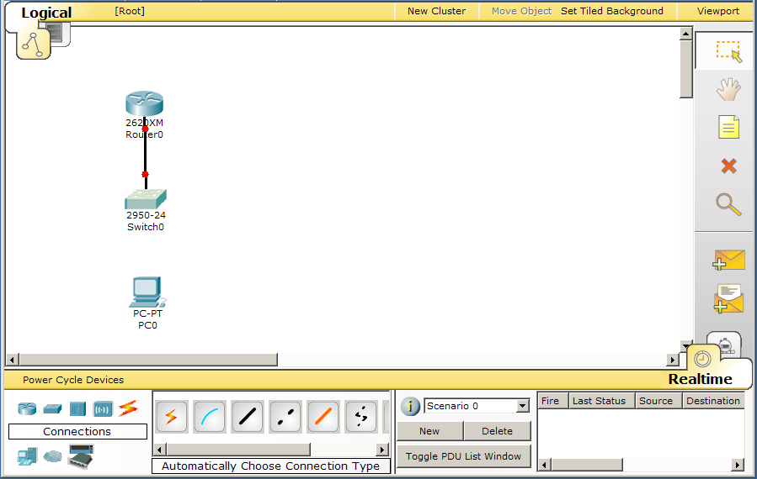
Smart Connection
To connect devices:
4. Click on the first device.
1. Click the Select tool, if necessary.
5. Click on the second device.
2. Choose the Connection icon.
3. Choose the Smart Connection icon.
Notes:
Slide 14 – Smart Connection
The Smart Connection is the easiest way for students to make connections between devices.
The Smart Connection will select the most common type of connection between devices. For instance, when connecting a router to a switch, the program will use a FastEthernet connection if a FastEthernet interface is available on both devices.
Later, when students have more skills with both Packet Tracer and networking, they will be able to choose a connection type and an interface manually.
Packet Tracer supports various connection types, including a console connection, crossover and straight through copper connections, serial DCE and DTE connections, coaxial, fiber, and phone lines.

Slide 20
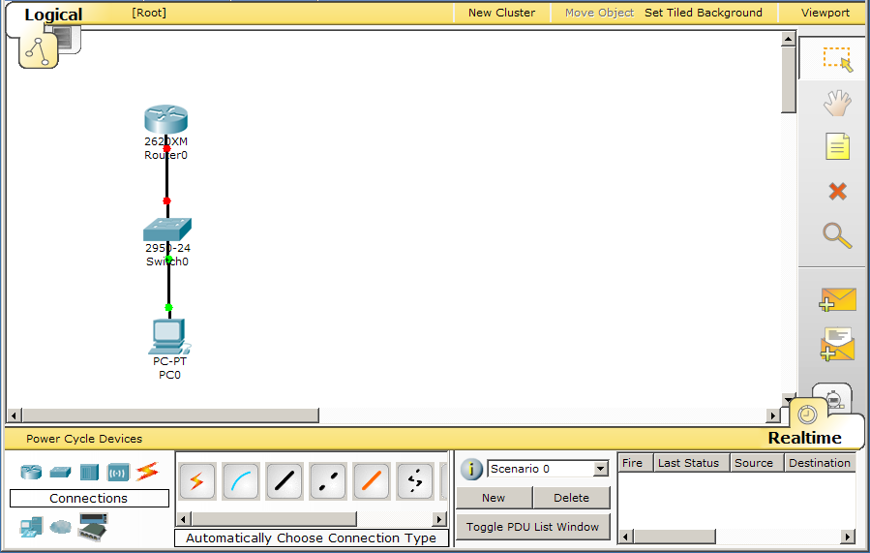
Port Status
Red indicates that the link is down.
Remember that the default state of a router interface is “shutdown”.
Notes:
Slide 15 – Port Status
Point out to students that the link between the switch and the router is down. This is because the FastEthernet interface on the router is “shutdown”.
The link between the PC and the switch is up, because the interfaces on these devices start up in an operational state.
These link lights are a quick visual way to determine if your links are operational.

Slide 21

Viewing Port Labels
Mouse over the connection to see which ports Packet Tracer selected when making the Smart Connection.
Notes:
Slide 16 – Viewing Port Labels
When using the Smart Connection, you may need to mouse over the connection to determine which ports on the devices were used for the connection.

Slide 22
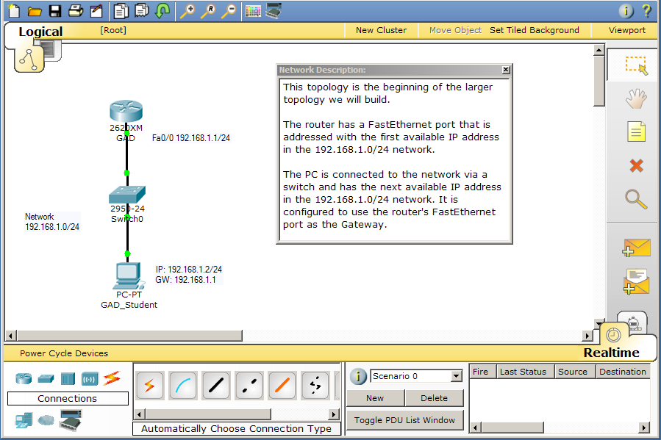
Network Description
Click on “I” icon to add a Network Description.
Notes:
Slide 27 – Network Description
You can use the Network Description text box to enter a description for the current network or other helpful information. When the saved file is opened by a user, this information can be displayed and will help the user understand the topology.
Clicking the “I” icon will show the window. Clicking the “x” will close the window.

Slide 23
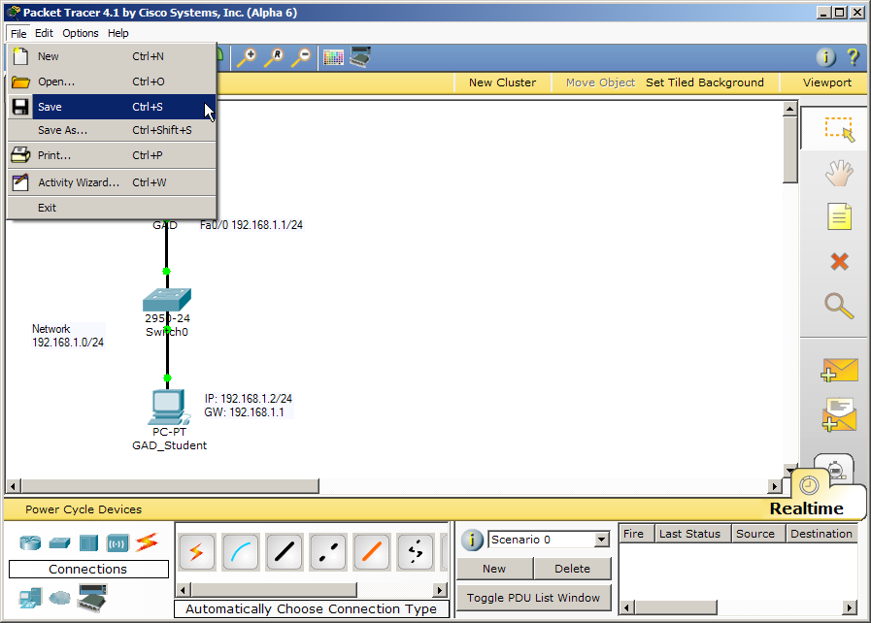
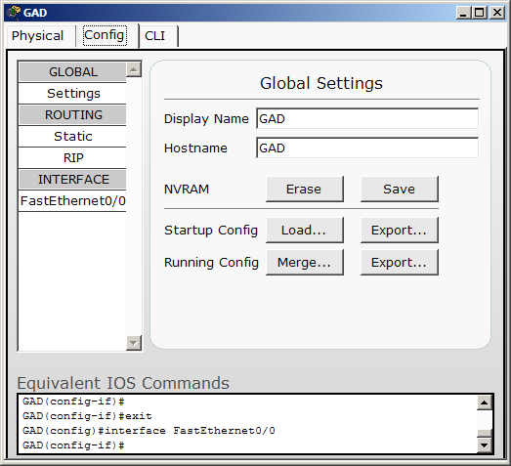
Save Your Configurations and File
Save your file by selecting File…Save
Save your router configs by clicking the NVRAM Save button.
Notes:
Slide 28 – Save Your Configurations and File
Router configs are lost if not saved when the router is powered off.
PC configs are saved automatically.
Packet Tracer files are saved with a .pkt ending. You can save the files anywhere on your computer or your network. Once saved, the file can be reopened and will contain all of the devices and configurations you entered.

Slide 24
POLL 4
Which of the following and end devices
PC
Laptop
Printer
All of the above

Slide 25


Slide 26


